Slide 1
Chapter 4
Database Performance Tuning and Query Optimization

Slide 2
Chapter Objectives
By the end of this chapter, you should be able to:
Identify the procedures involved in database performance tuning
Describe how a DBMS processes SQL queries in each of its three phases
Explain the role of indexes in speeding up data access
Differentiate between a rule-based optimizer and a cost-based optimizer
Describe some common practices used to write efficient SQL code
Explain how to formulate queries and tune the DBMS for optimal performance

Slide 3
Database Performance-Tuning Concepts (1 of 2)
One of the main functions of a database system is to provide timely answers to end users
End users interact with the DBMS through the use of queries to generate information, using the following sequence:
1. End-user (client-end) application generates a query
2. Query is sent to the DBMS (server end)
3. DBMS (server end) executes the query
4. DBMS sends the resulting data set to the end-user (client-end) application
-Client asks → Server finds → Server sends back → Client displays.

Slide 4
Database Performance-Tuning Concepts (2 of 2)
The goal of database performance is to execute queries as fast as possible
Database performance tuning is a set of activities and procedures designed to reduce the response time of a database system
Fine-tuning the performance of a system requires a holistic approach
All factors must be checked to ensure that each one operates at optimum levels with minimal bottlenecks
Database tuning = finding and fixing anything that slows queries down

Slide 5
Performance Tuning: Client and Server
On the client side, the objective is to generate a SQL query that returns the correct answer in the least amount of time, using the minimum amount of resources at the server end
Commonly referred to as SQL performance tuning
On the server side, the DBMS environment is configured to respond to clients’ requests as fast as possible, while making optimum use of existing resources
Commonly referred to as DBMS performance tuning
Example for client side:
Instead of saying:
SELECT * FROM Customers;
(which brings everything)
SELECT name, phone FROM Customers WHERE city = 'New York’;
(only the info you need).
Example for sever side: Make the database server itself run fast by:
Adding more RAM
Using indexes (shortcuts to find data).
Adjusting caches for speed
-Client tuning = better questions.
-Server tuning = faster answers.

Slide 6
DBMS Architecture (1 of 3)
The architecture of a DBMS is represented by the processes and structures (in memory and permanent storage) used to manage a database.
All data in a database are stored in data files
Data blocks The smallest piece of storage in a database. Each data file is divided into blocks to store records.
Extents A group of data blocks assigned together to store a table or object. Several boxes grouped together for one big order.
Data files are grouped in file groups or table spaces
A table space is a logical grouping of several data files that store data with similar characteristics. Eg All customer tables in one table space, all sales tables in another.
The data cache or buffer cache is a shared, reserved memory area that stores the most recently executed SQL statements or PL/SQL procedures

Slide 7
DBMS Architecture (2 of 3)
The SQL cache, or procedure cache, is a shared, reserved memory area that stores the most recently executed SQL statements or PL/SQL procedures
The DBMS retrieves data from permanent storage and places it in RAM
Data is retrieved from the data files and placed in the data cache
To move data from permanent storage (data files) to RAM (data cache), the DBMS issues I/O requests and waits for the replies
An input/output request is a low-level data access operation that reads or writes data to and from computer devices, such as memory, hard disks, video, and printers
Working with data in the data cache is faster than working with data files
Most performance-tuning activities focus on minimizing I/O operations

Slide 8
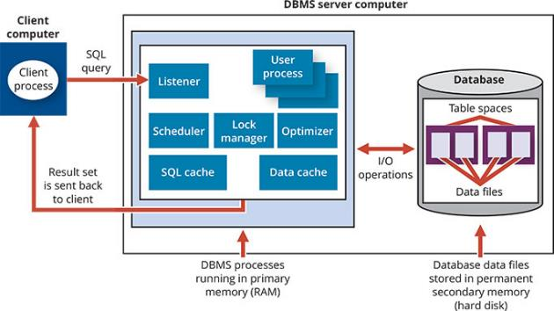
DBMS Architecture (3 of 3)
Figure 11.1 Basic DBMS Architecture

Slide 9
Database Query Optimization Modes (1 of 3)
Most of the algorithms proposed for query optimization are based on two principles:
The selection of the optimum execution order to achieve the fastest execution time
The selection of sites to be accessed to minimize communication costs
Within those two principles, a query optimization algorithm can be evaluated based on:
Its operation mode
The timing of its optimization

Slide 10
Database Query Optimization Modes (2 of 3)
Operation modes can be classified by the following:
Automatic query optimization means that the DBMS finds the most cost-effective access path without user intervention
Manual query optimization requires that optimization be selected and scheduled by the end-user or programmer
Query optimization algorithms can be classified according to when the optimization is done
Static query optimization takes place at compilation time
Dynamic query optimization takes place at execution time

Slide 11
Database Query Optimization Modes (3 of 3)
Query optimization techniques can be classified according to the type of information used to optimize the query
A statistically based query optimization algorithm uses statistical information about the DBMS to determine the best access strategy
Statistical information is managed by the DBMS and is generated in one of two different modes:
Dynamic statistical generation mode
Manual statistical generation mode
A rule-based query optimization algorithm is based on a set of user-defined rules to determine the best query access strategy

Slide 12
Database Statistics (1 of 2)
Database statistics refers to a number of measurements about database objects, such as the following:
Number of processors used
Processor speed
Temporary space available
Statistics provide a snapshot of database characteristics

Slide 13
Database Statistics (2 of 2)
Table 11.2 | Sample Database Statistics Measurements
Database Object | Sample Measurements
Tables | Number of rows, number of disk blocks used, row length, number of columns in each row, number of distinct values in each column, maximum value in each column, minimum value in each column, and columns that have indexes
Indexes | Number and name of columns in the index key, number of key values in the index, number of distinct key values in the index key, histogram of key values in an index, and number of disk pages used by the index
Environment Resources | Logical and physical disk block size, location and size of data files, and number of extends per data file

Slide 14
Knowledge Check Activity 11-1
What is SQL performance tuning?

Slide 15
Knowledge Check Activity 11-1: Answer
What is SQL performance tuning?
Answer: SQL performance tuning describes a process – on the client side – that will generate an SQL query to return the correct answer in the least amount of time, using the minimum amount of resources at the server end.

Slide 16
Query Processing (1 of 2)
The DBMS processes a query in three phases:
1. Parsing: The DBMS parses the SQL query and chooses the most efficient access/execution plan
2. Execution: The DBMS executes the SQL query using the chosen execution plan
3. Fetching: The DBMS fetches the data and sends the result set back to the client

Slide 17
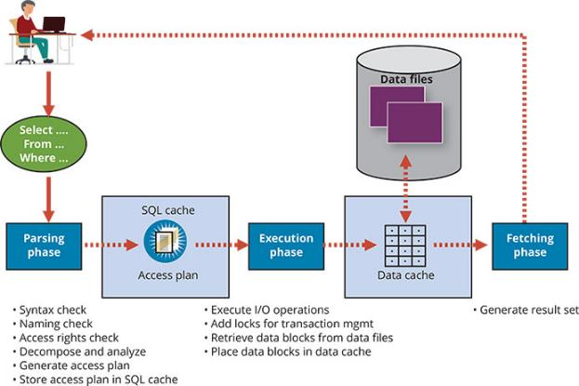
Query Processing (2 of 2)
Figure 11.2 Query Processing

Slide 18
SQL Parsing Phase (1 of 2)
The optimization process includes breaking down the query into smaller units
The original SQL query is transformed into slightly different version of original SQL code which is fully equivalent and more efficient
SQL parsing is performed by the query optimizer, which analyzes the SQL query and finds the most efficient way to access data
An access plan is the result of parsing a SQL statement; it contains a series of steps the DBMS will use to execute the query and return the result set in the most efficient way
If an access plan exists for the query in SQL cache, the DBMS reuses it
If there is no access plan, the optimizer evaluates various plans and chooses one to be placed in SQL cache for use

Slide 19
SQL Parsing Phase (2 of 2)
Table 11.3 | Sample DBMS Access Plan I/O Operations
Operation | Description
Table scan (full) | Reads the entire table sequentially, from the first row to the last, one row at a time (slowest)
Table access (row ID) | Reads a table row directly, using the row ID value (fastest)
Index scan (range) | Reads the index first to obtain the row IDs and then accesses the table rows directly (faster than a full table scan)
Index access (unique) | Used when a table has a unique index in a column
Nested loop | Reads and compares a set of values to another set of values, using a nested loop style (slow)
Merge | Merges two data sets (slow)
Sort | Sorts a data set (slow)

Slide 20
SQL Execution Phase
In this phase, all I/O operations indicated in the access plan are executed
The proper locks are acquired for the data to be accessed
The data is retrieved and placed in the DBMS’s data cache
All transaction management commands are processed during the parsing and execution phases of query processing

Slide 21
SQL Fetching Phase
After the parsing and execution phases are completed, all rows that match the specified condition(s) are retrieved, sorted, grouped, and aggregated
During the fetching phase, the rows of the resulting query results set are returned to the client
The DBMS may use temporary table space to store temporary data
In this stage, the database server coordinates the movement of the result set rows from the server cache to the client cache

Slide 22
Query Processing Bottlenecks
A query processing bottleneck is a delay introduced in the processing of an I/O operation that slows the system
Within a DBMS, the following five components typically cause bottlenecks:
CPU
RAM
Hard disk
Network
Application code

Slide 23
Indexes and Query Optimization (1 of 4)
Indexes help speed up data access
They facilitate searching, sorting, using aggregate functions, and join operations
An index is an ordered set of values that contain the index key and pointers
An index scan is more efficient than a full table scan because the index data is preordered and the amount of data is usually much smaller

Slide 24
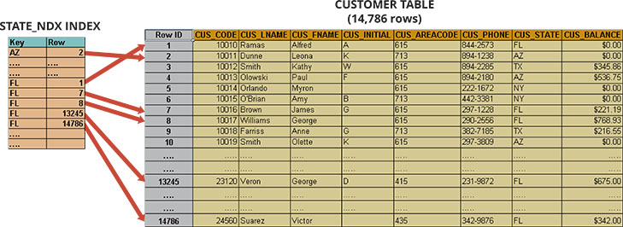
Indexes and Query Optimization (2 of 4)
Figure 11.3 Index Representation for the Customer Table

Slide 25
Indexes and Query Optimization (3 of 4)
Data sparsity refers to the number of different values a column could have
Data structures used to implement indexes include the following:
Hash index, which is an index based on an ordered list of hash values
B-tree index, which is an ordered data structure organized as an upside-down tree
Bitmap index, which is an index that uses a bit array (0s and 1s) to represent the existence of a value or condition
Current-generation DBMSs are intelligent enough to determine the best type of index to use under certain circumstances
Provided the DBMS has updated database statistics

Slide 26
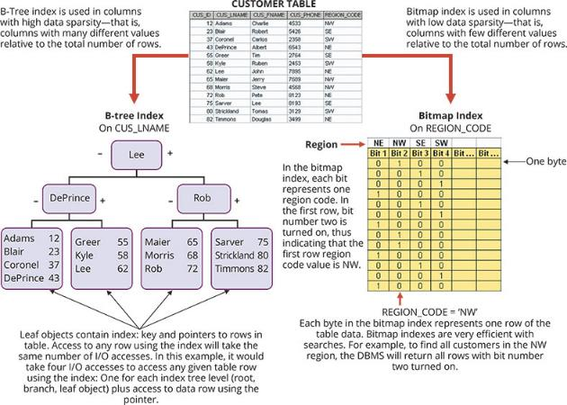
Indexes and Query Optimization (4 of 4)
Figure 11.4 B-Tree and Bitmap Index Representation

Slide 27
Knowledge Check Activity 11-2
If indexes are so important, why not index every column in every table?

Slide 28
Knowledge Check Activity 11-2: Answer
If indexes are so important, why not index every column in every table?
Answer: Indexing every column in every table will tax the DBMS too much in terms of index-maintenance processing, especially if the table has many attributes, many rows, and/or requires many inserts, updates, and/or deletes.

Slide 29
Optimizer Choices
The query optimizer can operate in one of two modes:
A rule-based optimizer uses preset rules and points to determine the best approach to execute a query
The rules assign a “fixed cost” to each SQL operation
A cost-based optimizer uses algorithms based on statistics about the objects being accessed to determine the best approach to execute a query
The optimizer process adds up the processing cost, I/O costs, and resource costs (RAM and temporary space) to determine the total cost of a given execution plan

Slide 30
Using Hints to Affect Optimizer Choices
In some instances, the optimizer might not choose the best execution plan
The optimizer makes decisions based on existing statistics; statistics might be old
Even with current statistics, the optimizer’s choice might not be the most efficient one
Optimizer hints are special instructions for the optimizer that are embedded in the SQL command text

Slide 31
SQL Performance Tuning
SQL performance tuning is evaluated from client perspective
Most current relational DBMSs perform automatic query optimization at the server end
Most SQL performance optimization techniques are DBMS-specific and thus rarely portable
The majority of performance problems are related to poorly written SQL code
A carefully written query almost always outperforms a poorly written one

Slide 32
Index Selectivity
Index selectivity is a measure of the likelihood that an index will be used in query processing
Indexes are used when a subset of rows from a large table is to be selected based on a given condition
You cannot always use an index to improve performance
A function-based index is an index based on a specific SQL function or expression

Slide 33
Conditional Expressions (1 of 3)
A conditional expression is normally placed within the WHERE or HAVING clauses of a SQL statement
It restricts the output of a query to only rows matching conditional criteria
The following practices are used to write efficient conditional expressions in SQL code:
Use simple columns or literals as operands
Numeric field comparisons are faster than character, date, and NULL comparisons
Equality comparisons are faster than inequality comparisons
Whenever possible, transform conditional expressions to use literals

Slide 34
Conditional Expressions (2 of 3)
The following practices are used to write efficient conditional expressions in SQL code (continued):
Write equality conditions first when using multiple conditional expressions
When using multiple AND conditions, write the condition most likely to be false first
When using multiple OR conditions, put the condition most likely to be true first
Whenever possible, try to avoid the use of NOT logical operator

Slide 35
Conditional Expressions (3 of 3)
Conditional Criteria
Table 11.6
OPERAND1 | CONDITIONAL OPERATOR | OPERAND2
P_PRICE | > | 10.00
V_STATE | = | FL
V_CONTACT | LIKE | Smith%
P_QOH | > | P_MIN * 1.10

Slide 36
Query Formulation
To formulate a query, you could normally follow these steps:
1. Identify what columns and computations are required
2. Identify source tables
3. Determine how to join the tables
4. Determine what selection criteria are needed
5. Determine the order in which to display the output

Slide 37
DBMS Performance Tuning (1 of 4)
DBMS performance tuning includes managing the DBMS processes in primary memory and managing the structures in physical storage
DBMS performance tuning at the server end focuses on setting parameters used for:
Data cache
SQL cache
Sort cache
Optimizer mode

Slide 38
DBMS Performance Tuning (2 of 4)
In-memory database systems are optimized to store large portions of the database in primary storage
These systems are becoming popular due to the following:
Increasing performance demands of modern database applications
Diminishing costs
Technology advances of components

Slide 39
DBMS Performance Tuning (3 of 4)
The following are general recommendations for physical storage of databases:
Use I/O accelerators
Use RAID (Redundant Array of Independent Disks) to provide a balance between performance improvement and fault tolerance
Minimize disk contention
Put high-usage tables in their own table spaces
Assign separate data files in separate storage volumes for indexes, system, and high-usage tables

Slide 40
DBMS Performance Tuning (4 of 4)
The following are general recommendations for physical storage of databases (continued):
Take advantage of the various table storage organizations in the database
An index-organized table (or clustered index table) is a table that stores the end-user data and the index data in consecutive locations on permanent storage
Partition tables based on usage
Apply denormalized tables where appropriate
Store computed and aggregate attributes in tables

Slide 41
Knowledge Check Activity 11-3
What does RAID stand for?

Slide 42
Knowledge Check Activity 11-3: Answer
What does RAID stand for?
Answer: RAID is the acronym for Redundant Array of Independent Disks. RAID is used to provide balance between performance and fault tolerance. RAID systems use multiple disks to create virtual disks (storage volumes) formed by several individual disks.

Slide 43
Summary
Now that the lesson has ended, you should be able to:
Identify the procedures involved in database performance tuning
Describe how a DBMS processes SQL queries in each of its three phases
Explain the role of indexes in speeding up data access
Differentiate between a rule-based optimizer and a cost-based optimizer
Describe some common practices used to write efficient SQL code
Explain how to formulate queries and tune the DBMS for optimal performance

